Slide 1

An Overview of Strategic Marketing
Chapter 1

Slide 2
Learning Objectives
LO 1-1 Define marketing.
LO 1-2 Explain the different variables of the marketing mix.
LO 1-3 Describe how marketing creates value.
LO 1-4 Briefly explore the marketing environment.
LO 1-5 Summarize the marketing concept.
LO 1-6 Identify the importance of building customer relationships.
LO 1-7 Explain why marketing is important to our global economy.

Slide 3
Defining Marketing
Marketing – The process of creating, distributing, promoting, and pricing goods, services, and ideas to facilitate satisfying exchange relationships with customers and to develop and maintain favorable relationships with stakeholders in a dynamic environment
The essence of marketing is to develop satisfying exchanges from which both customers and marketers benefit
Customers – The purchasers of organizations’ products
  Are the focal point of all marketing activities
Target market – A specific group of customers on whom an organization focuses its marketing efforts

Slide 4
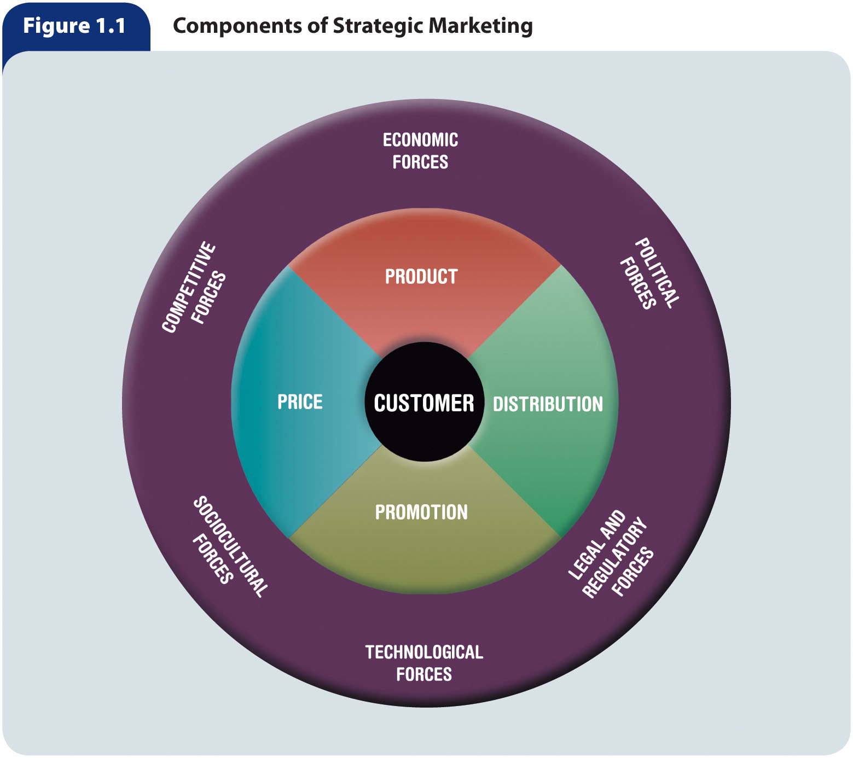
Figure 1.1 – Components of Strategic Marketing

Slide 5
Marketing Deals with Products, Distribution, Promotion, and Price (slide 1 of 2)
Marketing is more than simply advertising or selling a product
  It involves:
    Developing and managing a product that will satisfy customer needs
    Promoting to help customers learn about the product and determine if the product will satisfy their needs
    Making the product available in the right place
    Pricing the product at an acceptable level for buyers
    Communicating information to help customers determine if the product will satisfy their needs

Slide 6
Marketing Deals with Products, Distribution, Promotion, and Price (slide 2 of 2)
Marketing mix – Four marketing activities—product, pricing, distribution, and promotion—that a firm can control to meet the needs of customers within its target market
  A firm can control these activities to meet the needs of customers within its target market
    There is a limit to how much these variables can be controlled
Marketers must:
  Strive to develop a marketing mix that matches the needs of customers in the target market
  Constantly monitor the competition and adapt their products, distribution decisions, promotion, and pricing to foster long-term success
  Collect in-depth, up-to-date information about customer needs, such as:
    The age, income, ethnicity, gender, and educational level of people in the target market
    Their preference for product features
    Their attitudes toward competitors’ products
    The frequency with which they use the product

Slide 7
The Product Variable
Product – A good, a service, or an idea
  Good – A physical entity that you can touch
  Service – The application of human and mechanical efforts to people or objects to provide intangible benefits to customers
  Idea – A concept, a philosophy, an image, or an issue
The product variable involves creating or modifying brand names and packaging
  May also include decisions regarding warranty and repair services
Product variable decisions and activities are important because they directly relate to customers’ needs and wants

Slide 8
The Distribution Variable
To satisfy customers, products must be available at the right time and in appropriate locations
A marketing manager makes products available in the quantities desired to as many target-market customers as possible while minimizing these three costs:
  Inventory
  Transportation
  Storage
A marketing manager also may:
  Select and motivate intermediaries (wholesalers and retailers)
  Establish and maintain inventory control procedures
  Develop and manage transportation and storage systems
The advent of the internet and electronic commerce has dramatically influenced the distribution variable
  Companies now can make their products available throughout the world without maintaining facilities in each country

Slide 9
The Promotion Variable
The promotion variable relates to activities used to inform and persuade to create a desired response
Promotion can:
  Increase public awareness of the organization and of new or existing products
  Inform customers about product features
  Urge people to take a particular stance on a political or social issue
  Help to sustain interest in established products

Slide 10
The Price Variable
The price variable relates to decisions and actions associated with pricing objectives and policies and actual product prices
  Price is a critical component of the marketing mix because customers are concerned about the value obtained in an exchange
  Price is often used as a competitive tool
  Intense price competition sometimes leads to price wars

Slide 11
Marketing Creates Value
Value – A customer’s subjective assessment of benefits relative to costs in determining the worth of a product
Customer benefits include anything a buyer receives in an exchange
Customer costs include anything a buyer must give up to obtain the benefits the product provides, including cost, time, effort, and risk
Value is a subjective assessment of benefits relative to costs
A product that demonstrates value usually has a feature or an enhancement that provides benefits
  Lowest price
  Convenience
  Availability

Slide 12
Marketing Builds Relationships with
Customers and Other Stakeholders (slide 1 of 2)
Exchanges – The provision or transfer of goods, services, or ideas in return for something of value
For an exchange to take place, four conditions must exist:
  Two or more individuals, groups, or organizations must participate, and each must possess something of value that the other party desires
  The exchange should provide a benefit or satisfaction to both parties involved in the transaction
  Each party must have confidence in the promise of the “something of value” held by the other
  To build trust, the parties to the exchange must meet expectations
Marketing activities should attempt to create and maintain satisfying exchange relationships
  To maintain an exchange relationship:
    Buyers must be satisfied with the good, service, or idea obtained
    Sellers must be satisfied with the financial reward or something else of value received

Slide 13
Marketing Builds Relationships with
Customers and Other Stakeholders (slide 2 of 2)
Stakeholders – Constituents who have a “stake,” or claim, in some aspect of a company’s products, operations, markets, industry, and outcomes
  Stakeholders include:
    Customers
    Employees
    Investors and shareholders
    Suppliers
    Governments
    Communities
    Competitors

Slide 14
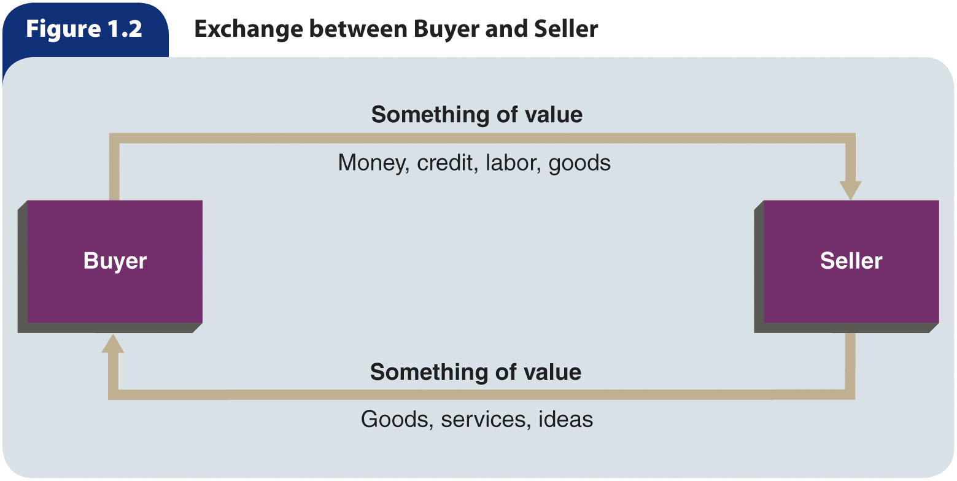
Figure 1.2 – Exchange between Buyer and Seller

Slide 15
Marketing Occurs in a
Dynamic Environment (slide 1 of 2)
Marketing environment – The competitive, economic, political, legal and regulatory, technological, and sociocultural forces that surround the customer and affect the marketing mix
The effects of these forces on buyers and sellers can be dramatic and difficult to predict
Their impact on value can be extensive as market changes can easily influence how stakeholders perceive certain products
These forces affect a marketer’s ability to facilitate value-driven exchanges in three general ways:
  Influence customers by affecting their lifestyles, standards of living, and preferences and needs for products
  Can determine whether and how a marketing manager can perform certain marketing activities
  May shape a marketing manager’s decisions and actions by influencing buyers’ reactions to the firm’s marketing mix

Slide 16
Marketing Occurs in a
Dynamic Environment (slide 2 of 2)
Because these forces are closely interrelated, changes in one way cause changes in others
Changes in the marketing environment produce uncertainty for marketers and at times hurt marketing efforts, but they also create opportunities
Compared to marketing-mix variables, an organization has far less control over the forces of the environment

Slide 17
Understanding the
Marketing Concept
Marketing concept – A managerial philosophy that an organization should try to satisfy customers’ needs through a coordinated set of activities that also allows the organization to achieve its goals
  The marketing concept is not a second definition of marketing but rather a management philosophy guiding an organization’s overall activities
  A firm that adopts the marketing concept must satisfy not only its customers’ objectives but also its own objectives
The evolution of marketing has gone through three periods, including:
  Production orientation
  Sales orientation
  Market orientation

Slide 18
The Production Orientation
During the second half of the 19th century, the Industrial Revolution improved speed and efficiency
As a result of new technology and new ways of using labor, products poured into the marketplace, where demand for manufactured goods was strong
Firms were developing the ability to produce more products, and competition was becoming more intense

Slide 19
The Sales Orientation
During the first half of the 20th century, competition increased and focus shifted to selling products to many buyers
Businesses viewed sales as the major means of increasing profits
Businesspeople believed that the most important marketing activities were personal selling, advertising, and distribution
Some people incorrectly equate marketing with a sales orientation
Some firms still use a sales orientation

Slide 20
The Market Orientation
Emerged in the mid-20th century
Market orientation – An organizationwide commitment to researching and responding to customer needs
Market orientation is linked to new product innovation by developing a strategic focus to explore and develop new products to serve target markets

Slide 21
Implementing the
Marketing Concept
Management must first establish an information system to discover customers’ real needs and then use the information to create satisfying products
  An information system is usually expensive; management must commit money and time for its development and maintenance
  Without an adequate information system, however, an organization cannot be market oriented
To satisfy customers’ objectives as well as its own, a company also must coordinate all of its activities
Implementing the marketing concept demands the support not only of top management but also of managers and staff at all levels of the organization

Slide 22
Customer Relationship Management
Customer relationship management – Using information about customers to create marketing strategies that develop and sustain desirable customer relationships
Achieving the full profit potential of each customer relationship should be the fundamental goal of every marketing strategy
Profits can be obtained through relationships in the following ways:
  By acquiring new customers
  By enhancing the profitability of existing customers
  By extending the duration of customer relationships
Implementing the marketing concept means optimizing the exchange relationship

Slide 23
Relationship Marketing
Relationship marketing – Establishing long-term, mutually satisfying buyer-seller relationships
  Focuses on value enhancement through the creation of more satisfying exchanges
  Continually deepens the buyer’s trust in the company
  Increases the firm’s understanding of the customer’s needs
To build long-term customer relationships, marketers are increasingly turning to marketing research and information technology
  Through the use of e-marketing, companies can personalize customer relationships
  on a nearly one-on-one basis

Slide 24
Customer Lifetime Value
Customer lifetime value (CLV) – A key measurement that forecasts a customer’s lifetime economic contribution based on continued relationship marketing efforts
  Requires identifying patterns of buying behavior and using that information to focus on the most promising and profitable customers
  Represents an intangible asset to a marketer that can be augmented by addressing the customer’s varying needs and preferences at different stages in his or her relationship with the firm
  May include an individual’s strong word-of-mouth communication about the company’s products
The emphasis changes from share of market to share of customer
  The most basic application of this idea is 80 percent of business profits come from 20 percent of customers
Can be calculated by taking the sum of the customer’s present value contributions to profit margins over a specific time frame
  Helps marketers determine how best to allocate resources to marketing strategies to sustain a customer over a lifetime

Slide 25
The Importance of Marketing in Our Global Economy (slide 1 of 3)
Marketing costs consume a sizable portion of buyers’ dollars
  About one-half of a buyer’s dollars goes toward marketing costs
Marketing is used in nonprofit organizations
  Government agencies at the federal, state, and local levels engage in marketing activities to fulfill their mission and goals
  In the private sector, nonprofit organizations employ marketing activities to create, distribute, promote, and price programs that benefit particular segments of society
Marketing is important to business and the economy
  Marketing activities help to produce the profits that are essential to the survival of individual businesses
  Marketing helps to create a successful economy and contributes to the well-being of society
Marketing fuels our global economy
  Advances in technology, along with falling political barriers and the universal desire for a higher standard of living, have made marketing across national borders commonplace while stimulating economic growth

Slide 26
The Importance of Marketing in Our Global Economy (slide 2 of 3)
Marketing knowledge enhances customer awareness
  Studying marketing allows us to understand the importance of marketing to customers, organizations, and our economy
Marketing connects people through technology
  Technology helps marketers to understand and satisfy more customers than ever before
  The Internet allows companies to disseminate information about their products and interact with target markets
Socially responsible marketing: Promoting the welfare of customers and stakeholders
  Green marketing – A strategic process involving stakeholder assessment to create meaningful long-term relationships with customers while maintaining, supporting, and enhancing the natural environment
  Market orientation combined with social responsibility improves overall business performance

Slide 27
The Importance of Marketing in Our Global Economy (slide 3 of 3)
Marketing offers many exciting career prospects
  From 25 to 33 percent of all civilian workers in the United States perform marketing activities
  The marketing field offers a variety of interesting and challenging career opportunities throughout the world, such as:
    Personal selling
    Advertising
    Packaging
    Transportation
    Storage
    Marketing research
    Product development
    Social media management
    Wholesaling
    Retailing

